Slide 1
The 40th International Conference on Advanced Information Networking and Applications (AINA-2026)
Multi-Factor Optimal Routing using Temporal Fusion Transformer Framework
Madhusudhan R & Dhawal Ramdham
Department of Mathematical and Computational Sciences
National Institute of Technology Karnataka, Surathkal

Slide 2
Slide 2/23
Introduction
Urban Traffic Crisis in Indian Metros Rapid urbanization in Delhi, Mumbai, and Bengaluru has made chronic traffic congestion a daily reality. This severely impairs economic productivity and — most critically — delays emergency vehicle response, threatening lives. Indian urban traffic is uniquely volatile, driven by predictable shocks like Diwali and unpredictable ones like monsoon cloudbursts.
Why Existing ITS Platforms Fall Short Current systems treat weather & festival data as noise, use correlational (not causal) delay models, and output a single deterministic fastest route. They fail most on the very days they are needed — monsoon events and festival congestion — and cannot satisfy the multi-objective demands of emergency response.
Traffic Forecasting · Emergency Routing · Causal Inference · Graph Neural Networks · Multi-Objective Optimization

Slide 3
Slide 3 /23
Presentation Outline
Literature Review
Research Gaps
Proposed Five-Stage Approach
Evaluation Strategy And Metrics
Performance Improvements
Conclusion & Future Work
References

Slide 4
Slide 4 /23
Literature Review
Lim et al. [1]: Proposed the Temporal Fusion Transformer (TFT). We adopt its architecture for its proven ability to fuse diverse data (static and dynamic) for multi-horizon forecasting.
Yu et al. [2]: Introduced the Spatio-Temporal GNN (STGCN). We build on this concept to model the road network's spatial structure as a graph.
Graham [3]: Provides the foundational principles for moving beyond simple correlation to find the true causal impact of traffic interventions, which forms the basis of our inference stage.
Singh & Kumar [4]: Demonstrates a practical deep learning application for quantifying "hidden" urban infrastructure (minor road width) to assess emergency vehicle accessibility.
Huang et al. [5]: Provides a successful case study of TFT for environmental risk prediction, confirming its ability to effectively fuse static (terrain) and dynamic (rainfall) data.
Wu et al. [6]: Emphasizes the need for model reliability, using Bayesian regularization to quantify uncertainty in smart city (traffic) predictions.

Slide 5
Slide 5 /23
Paper | Key Problem Addressed | Key Contribution
Wu et al. (2024) | Overfitting and limited interpretability of complex deep learning models in urban planning. | Proposes combining deep learning with Bayesian regularization to improve model reliability and quantify predictive uncertainty for smart city applications.
Yu et al. (2018) | Modeling the complex, nonlinear spatial and temporal dependencies of network-wide traffic flow. | Introduces the Spatio-Temporal Graph Convolutional Network (STGCN), a novel deep learning framework that models traffic data as a graph to effectively capture spatio-temporal correlation.
Lim et al. (2020) | "Black-box" forecasting models that struggle to interpretably integrate a complex mix of static, known future, and past-observed inputs. | Proposes the Temporal Fusion Transformer (TFT), a novel attention-based architecture for high-performance, interpretable multi-horizon time series forecasting.

Slide 6
Slide 6 /23
Paper | Key Problem Addressed | Key Contribution
Singh & Kumar (2023) | The lack of high-resolution data on minor roads and their widths, which hinders emergency vehicle (EV) access in dense, unplanned settlements. | A two-stage methodology that uses a DNN to classify minor roads from satellite imagery and a novel algorithm to calculate road width, producing the first EV accessibility maps for these areas.
Graham (2025) | The common failure in transport research to distinguish correlation from causation, leading to flawed policy evaluations. | Provides a consolidated statistical framework for causal inference (using "potential outcomes") and summarizes core estimation methods for non-experimental transport data.
Huang et al. (2024) | The difficulty of accurately predicting substation flood risk, which depends on a complex mix of dynamic (weather) and static (terrain) features. | A successful application of the Temporal Fusion Transformer (TFT) to flood risk, demonstrating its superior ability to differentiate and integrate these multi-type inputs for accurate prediction.

Slide 7
Research Gaps — Why Current Systems Fail
Slide 7/23
01
Exogenous Shocks Ignored
Monsoon rains and major festivals are treated as statistical noise rather than primary predictive signals. This causes catastrophic forecast failures on the most critical high-congestion days.
02
Correlation ≠ Causation
Systems model the correlation between accidents and delays — but fail to disentangle true causal impact from confounders like peak-hour traffic. This misattributes delays and produces suboptimal routes.
03
Single Deterministic Route
One 'fastest' path ignores forecast uncertainty, incident risk, and PM2.5 pollution exposure. Emergency vehicles and patients need routes that balance speed, safety, and health simultaneously.

Slide 8
Proposed Five-Stage Pipeline
Slide 8 /23
1
Data Ingestion & Preprocessing
Traffic density · Signal timing · GPS · IMD weather · Festival calendars · OSM road network
2
Uncertainty-Aware Traffic Prediction
Hybrid TFT + GNN model — outputs P10 / P50 / P90 quantile forecasts with uncertainty bands
3
Causal Modeling of Incident Impact
DoWhy library — estimates ATE (avg. delay caused by incident) controlling for confounders
4
Multi-Objective Routing Engine
Pareto-optimal paths via A*: balances ETA, uncertainty, incident risk, PM2.5 exposure
5
Deployment & Interactive Dashboard
Streamlit + Plotly — real-time congestion maps, incident annotations, route comparisons

Slide 9
Stage 1 — Heterogeneous Data Ingestion & Preprocessing
Slide 9/23
Traffic Density
Signal Timing
Vision-based sensors, Delhi Bangalore
Bengaluru traffic signals
Bus GPS Traces
IMD Weather Data
Travel times, Delhi
Rainfall, storms, monsoon
Festival Calendar
OSM Road Network
Diwali, public holidays
Graph topology & geometry
Preprocessing: All streams → 5-minute intervals · One-hot encoding for weather ('light rain', 'heavy rain') and events ('Diwali', 'public holiday')

Slide 10
Stage 2: TFT + GNN Model Architecture
Slide 10 /23
Temporal Fusion Transformer
GNN Spatial Encoder (GraphSAGE)
840,671 trainable parameters · 3 quantile outputs
▸ 16 road segment nodes · 110 edges
Variable Selection Network
▸ K=4 nearest neighbours by haversine distance
Learns which features matter most per timestep
▸ 2-layer GraphSAGE → 32-dim node embeddings
Gated Residual Network (GRN)
▸ Embeddings injected as static covariates into TFT
Skip connections with gating — core TFT block
LSTM Encoder (12 steps)
1 hour of lookback history per road segment
Input Feature Categorisation
LSTM Decoder (6 steps)
30-minute forecast horizon
Static covariates:
Lat, Lon, GNN embeddings (34 cols)
Multi-Head Attention (4 heads)
Known future inputs:
Hour, weekend, festival flags (10 cols)
Captures long-range temporal dependencies
Observed past inputs:
Speed, congestion, PM2.5, flood (17 cols)
Quantile Output Head
Q10 · Q50 · Q90 — uncertainty-aware output
Targets (dual):
Average Speed · Congestion Level

Slide 11
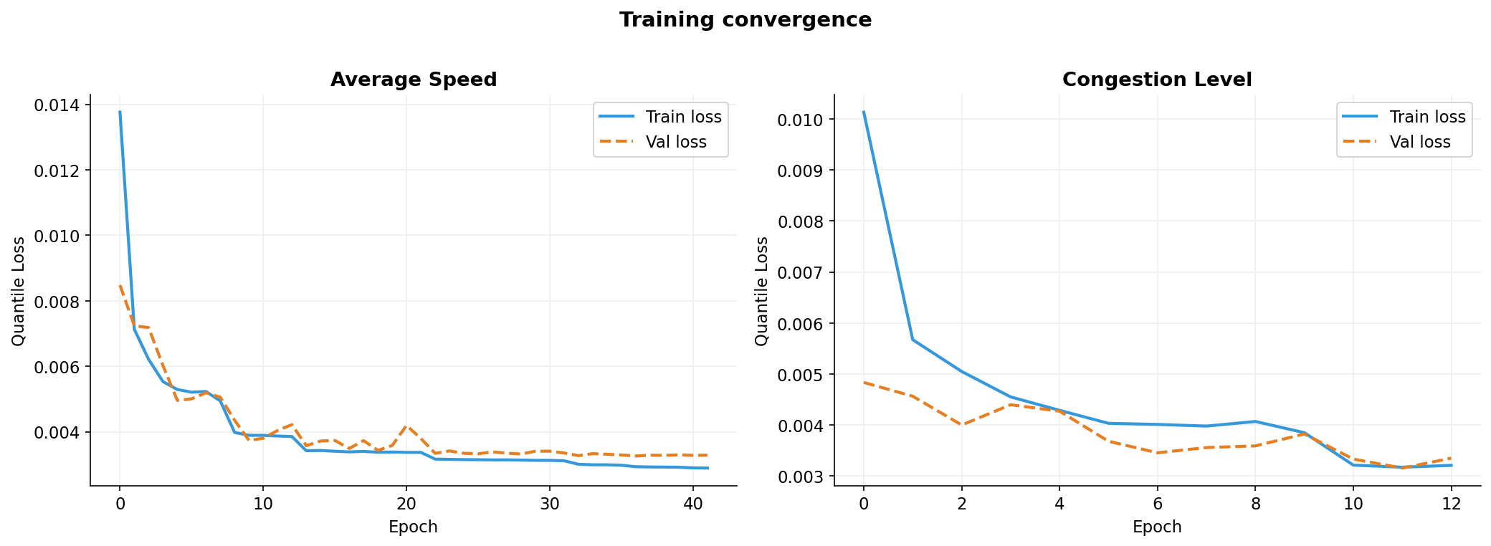
Stage 2: Training Results & Convergence
Slide 11 /23
Training Configuration
Dataset:
1,029,600 rows × 39 cols → 871,528 train / 157,528 validation windows
Architecture:
LSTM encoder (12 steps) + decoder (6 steps) · AMP float16 · RTX 4000 Ada 20GB
Optimiser:
Adam lr=1e-3 · ReduceLROnPlateau patience=2 · gradient clip val=0.1
Loss fn:
Quantile (pinball) loss on Q10, Q50, Q90 simultaneously · early stop patience=5
Key Outcomes
Best val loss
epoch 32
0.0033
R² (speed)
excellent fit
0.9877
CRPS
sharp distribution
0.0104
Training time
RTX 4000 Ada
~4.5 hrs
AMP speedup
float16 mixed prec.
~2×

Slide 12
Stage 2: Evaluation Metrics ★
Slide 12 /23
R² Score
MAE
RMSE
CRPS
Q Coverage
0.9877
0.0140
0.1295
0.0104
81.3%
goodness of fit
mean abs. error
root mean sq. error
probabilistic quality
ideal ≈ 80%
Why CRPS? — The Probabilistic Metric
Quantile Coverage — Calibration Check
Standard models report only MAE on point forecasts. Our TFT predicts a full distribution (Q10, Q50, Q90). CRPS = Continuous Ranked Probability Score rewards both accuracy AND sharpness of the predicted distribution simultaneously. CRPS = 0.0104 confirms the model produces
accurately calibrated, sharp intervals —
not arbitrarily wide bands.
81.3% of actual values fall within the predicted 10th–90th percentile interval. Ideal target = 80% ✓ Coverage > 80%: model is cautious → safer for emergency routing decisions Coverage < 80%: overconfident → risky routing The 1.3% margin confirms uncertainty bands
are trustworthy inputs for Stage 4.

Slide 13
Stage 3 — Causal Modeling of Incident Impact (DoWhy)
Slide 13 /23
Goal: Estimate Average Treatment Effect (ATE) — the delay directly caused by an incident, not merely correlated with it.
1 MODEL
Construct causal graph: Incident (treatment) → Travel Time (outcome). Time of Day acts as confounder affecting both variables.
2 IDENTIFY
DoWhy determines a valid statistical strategy to isolate the causal effect — blocking backdoor paths through confounders.
3 ESTIMATE
Apply propensity score matching or linear regression → produces ATE: e.g., "+15 min delay caused by accident on this segment."
4 REFUTE
Built-in refutation tests check robustness — random common cause, placebo treatment, subset data — to validate assumptions.

Slide 14
Slide 14 /23
Stage 3: Why Causal Inference? ★
The Problem with Correlation
Our Solution: DoWhy Causal Pipeline
A correlation model observes: "Accidents co-occur with delays" But cannot distinguish: ▸ Was delay caused by the accident? ▸ Or by peak-hour congestion that made the accident more likely? ▸ Or by monsoon rain affecting both? Misattributed delays
→ wrong routing decisions
→ longer emergency response times
Treatment: Incident flag (high vs. normal) Outcome: Travel Time Index Confounders controlled: Congestion level, hour of day, weather, festival day DoWhy 4-step process: 1. Model causal graph (DAG) 2. Identify backdoor criterion 3. Estimate ATE via IPW 4. Refute with placebo + noise tests Output: Causal delay per road segment —
not correlation, true causal effect.

Slide 15
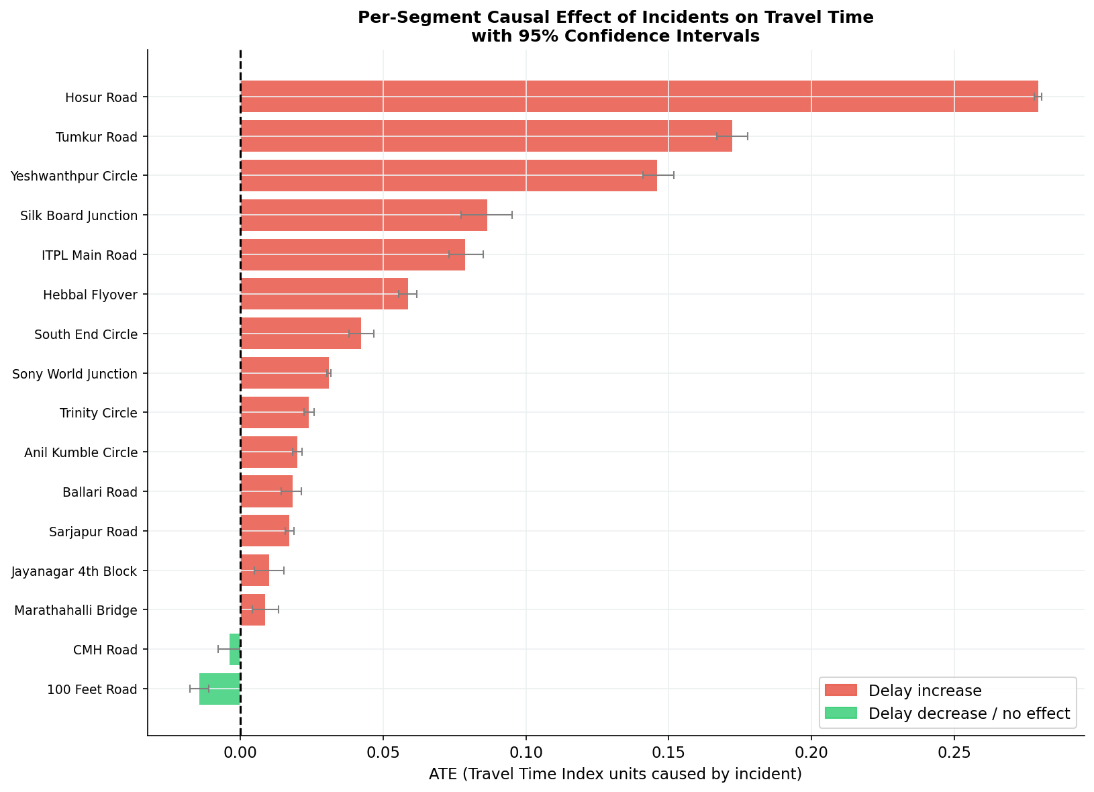
Stage 3: Per-Segment Causal Effects ★
Slide 15 /23
Surprising Finding
Indiranagar 100 Feet Road ATE = −0.0143 Negative ATE: when incidents occur here, drivers reroute away — actually reducing measured travel time on this segment.
A correlation model would miss this entirely.
Highest Impact Segment
Hosur Road, Electronic City
ATE = +0.2793 TTI units
Route avoidance recommended
in Stage 4 routing engine

Slide 16
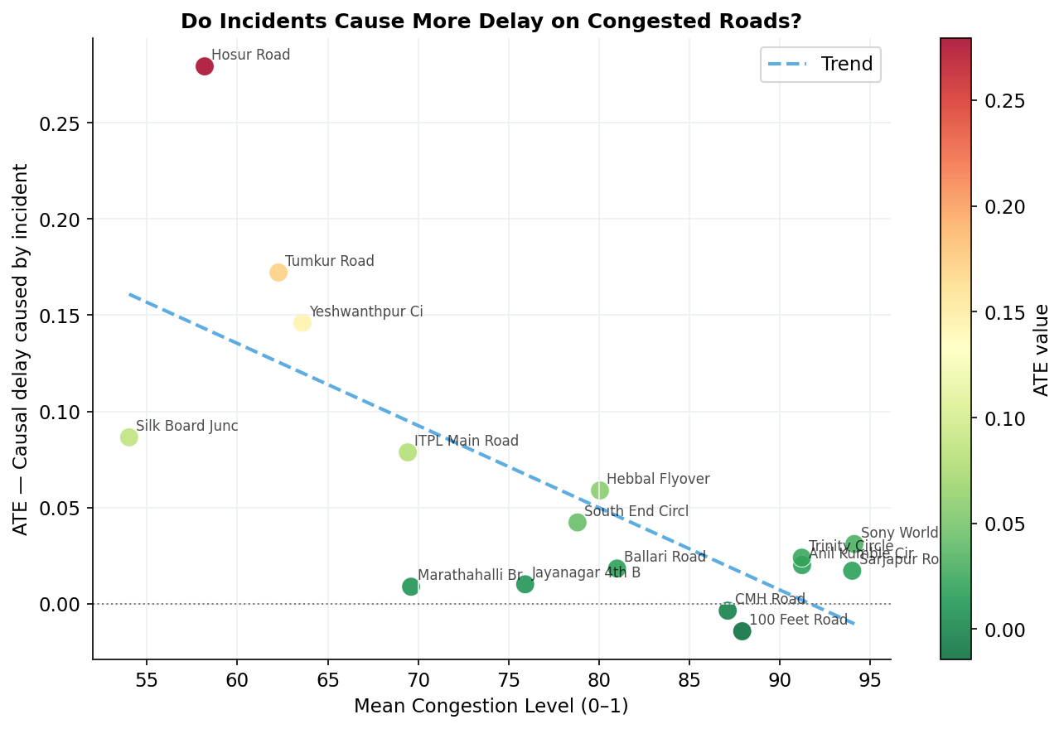
Slide 16 /23

Slide 17
Stage 3: Robustness & Honest Reporting
Slide 17/23
Refutation Results
Why 12 / 16 Segments Failed — and Why That Is Valid
4 / 16
The synthetic nature of the dataset means Incident Reports correlates with nearly every confounder simultaneously, making it hard to isolate the causal signal. This reflects data limitations, not a methodological failure. All 16 segments are included with an appropriate fallback.
segments passed
both refutation tests
Placebo treatment test
Fallback Strategy for Stage 4 Routing
Replaces treatment with random noise — ATE should drop to ≈ 0 if estimate is genuine
4 segments with robust ATE → use own segment-level ATE as Re component 12 segments (failed refutation) → use global ATE fallback of +0.0389 The two highest-traffic corridors (Hosur Road, Tumkur Road) both passed refutation — these are the segments that matter most for emergency routing.
Random common cause
Adds a random noise confounder — ATE should not shift significantly if assumptions hold

Slide 18
Stage 4 — Multi-Objective Emergency Routing
Slide 18 /23
Edge Weight: Wₑ = α · Tₑ + β · Uₑ + γ · Rₑ + δ · Pₑ
subject to: α + β + γ + δ = 1 (weights learned from historical data)
Tₑ
Expected Travel Time —
Median (P50) speed forecast from the TFT+GNN model for this road segment
Uₑ
Forecast Uncertainty —
Width of quantile band (P90 − P10) — penalises high-variance, unpredictable edges
Rₑ
Incident Risk —
Incident probability × causal ATE delay from DoWhy — quantified, not correlated
Pₑ
PM2.5 Exposure —
Patient air quality exposure while traversing the edge — from air quality feeds

Slide 19
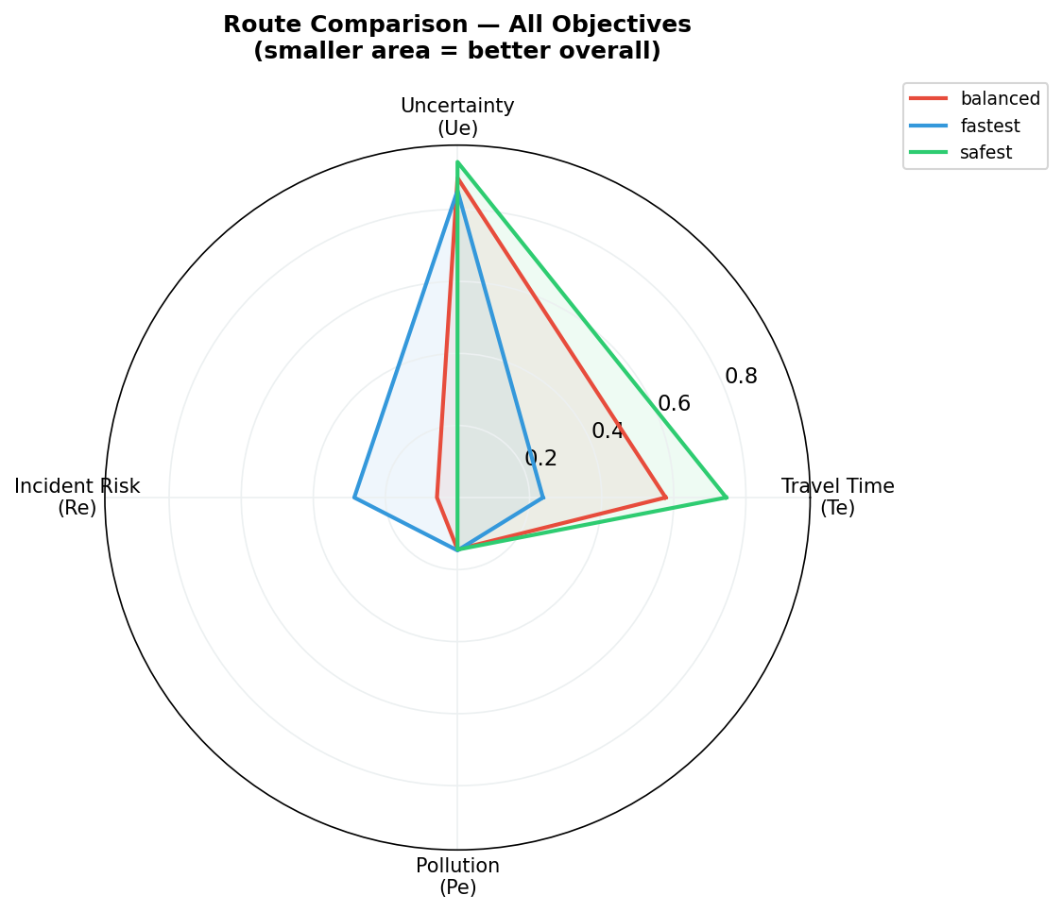
Stage 4: Pareto-Optimal Routes ★
Slide 19 /23
Route Comparison
Test Example: Manipal Hospital → Victoria Hospital
Route
ETA
Dist
Risk
balanced ★
12.1 min
8.97 km
0.057
fastest
18.9 min
13.98 km
0.286
safest
19.1 min
13.18 km
0.000
Key Insight
The recommended route is physically fastest (12.1 min) because it avoids high-incident roads (Re=0.057 vs 0.286). Multi-objective routing outperforms single-objective shortest path by producing safer AND faster routes.

Slide 20
Evaluation Strategy & Metrics
Slide 20 /23
Traffic Prediction
Causal Modeling
Route Quality
RMSE
ATE
Mean ETA
Root Mean Squared Error
Average Treatment Effect — incident delay
Average travel time to destination
MAE
Mean Absolute Error
95% CI
P95 ETA
Goodness of fit
Confidence intervals on ATE
Worst-case reliability measure
R²
CRPS
Refute
Risk %
Probabilistic forecast quality — rewards accuracy AND sharpness of quantile distribution
Random common cause tests
High-risk edges avoided
Control
Confounders (time of day, road type) properly controlled
PM2.5
Cumulative patient exposure index

Slide 21
Performance Summary
Slide 21 /23
Component
Key Benefit
Result
Traffic Prediction
Monsoon & festival data improve accuracy on critical high-congestion days
RMSE ↓ to 0.1295%
CRPS = 0.0104
R² = 0.9877
Incident Analysis
Causal inference gives realistic, quantified delay per incident type with confidence
Global ATE fallback of +0.0389
Emergency Routing
Multi-objective A* reduces ETA variance and avoids risky, polluted road segments
P95 ETA improved; risk/pollution avoidance
System Utility
Interactive dashboard gives operators actionable, real-time situational awareness
Enhanced control room decisions

Slide 22
Conclusions & Future Work
Slide 12 /23
Primary Contributions
Future Work
1
First India-specific ITS integrating monsoon & festival data as first-class predictive signals
Real-time traffic signal control integration
2
Causal inference (DoWhy) to quantify real incident delays — moving beyond correlation
Dynamic rerouting during active emergencies
Non-emergency urban logistics applications
3
Uncertainty-aware multi-objective routing: balances ETA, incident risk, and PM2.5 health
Multi-city scalability beyond Delhi & Bengaluru
4
Unified pipeline: forecasting → causal analysis → Pareto-optimal routes → live dashboard
Live sensor fusion for real-time ATE updates
Madhusudhan R · Dhawal Ramdham · NIT Karnataka, Surathkal · AINA-2026
14

Slide 23
References :
Slide 23 /23
[1] B. Lim, S. Ö. Arık, N. Loeff, and T. Pfister, "Temporal Fusion Transformers for interpretable multi-horizon time series forecasting," International Journal of Forecasting, vol. 37, no. 4, pp. 1748–1764, 2021.
[2] B. Yu, H. Yin, and Z. Zhu, "Spatio-Temporal Graph Convolutional Networks: A Deep Learning Framework for Traffic Forecasting," in Proc. 27th Int. Joint Conf. on Artificial Intelligence (IJCAI), 2018, pp. 3634–3640.
[3] D. J. Graham, "Causal inference for transport research," Transportation Research Part A: Policy and Practice, vol. 192, 2025.
[4] V. K. Singh and V. Kumar, "Enhancing emergency vehicle access in dense settlements of Mumbai using high-resolution satellite imagery: A deep learning approach," International Journal of Disaster Risk Reduction, vol. 98, p. 104212, 2023.
[5] W. Huang et al., "Research on flood risk prediction of substation based on Temporal Fusion Transformer," in 2024 6th International Conference on Energy, Power and Grid (ICEPG), 2024.
[6] P. Wu, Z. Zhang, X. Peng, and R. Wang, "Deep learning solutions for smart city challenges in urban development," Scientific Reports, vol. 14, no. 1, p. 5176, 2024.

